Slide 1

ICEG
REVIEW COMITE
15/01/2026
WIFI:
https://bezoekersregistratie.vlaanderen.be/wifi/zelfregistratie

Slide 2
Welcome & agenda of the meeting

Slide 3
AGENDA
Topic | Speaker | Notes
Update standardisation exercises | Pauline | ICEG Person Extension ICEG Hydrants Assessment BEST
Update exercise translation OSLO standards | Eveline | Status
EU Survey Interoperability Framework / SDG | Ziggy | Update on the feedback received so far (Flanders and BOSA) and discussion if there is a wish to provide additional input to the draft document for the EU EIF/SDG survey.
Meetings for 2026 | Eveline | Proposal dates

Slide 4
Update standardisation excercises Pauline De Wolf

Slide 5
ICEG Person Pauline De Wolf

Slide 6
Context
Information on a Person is vital for any public service.
Currently this information is exchanged via a variety of technical solutions, each with their own non-harmonised data model.
ICEG Person has been in the works for quite some time.
Draft Charter has already been published here:
Notes:
Thematische WP:
Socio economische gegevens
Gezondheid
Water
Biodiversiteit
Werkgelegenheid en opleiding
Mobiliteit

Slide 7
Context (2)
During the assessment multiple needs for the ICEG Person track were identified:
Need for a generic ICEG vocabulary (temporal references,…)
Need for address layer above BeSt in order to capture unstructured or semi-structured address / location data. Belgian public service will usually want to make a distinction between domestic, European and third-country locations.
Need for a base registry model or at the very least a person registry model. Modeling these data points (historic versioning, traceability on multiple dimensions,…) requires its own follow-up traject.
Hooks for legal data points not yet present in ICEG Person (OSLO Persoon).
Notes:
Thematische WP:
Socio economische gegevens
Gezondheid
Water
Biodiversiteit
Werkgelegenheid en opleiding
Mobiliteit

Slide 8
Activity
Initial draft model was created in 2024 based on the identified requirements.
Semantic Architect at Digital Flanders has already updated the model to be ready for Working Groups and the start of the standardisation track.
Depenencies: OSLO initiative to make information of Persons available via OSLO Persoon as JSON-LD via a REST API (preferably aligned later with ICEG Person)
Next step would be to start the actual standardisation track with Digital Flanders in the lead for the modelling, aligned with the European Core Person Vocabulary and OSLO Persoon and adhering to the requirements set out in the charter.
Notes:
Thematische WP:
Socio economische gegevens
Gezondheid
Water
Biodiversiteit
Werkgelegenheid en opleiding
Mobiliteit

Slide 9
Potential timeline
Before end of Q1: Creation of a core team of stakeholders that can steer the editors and is responsible for participation of the relevant stakeholders (KSZ, National Register, Digitaal Vlaanderen's MAGDA service, SPW, etc.)
Before end of Q1: Business Working Group in which the scope is finalised together with the stakeholders to build consensus
Before end of Q2: Thematic Working Group 1 & 2 in which the model is discussed in detail
Before end of Q4: Thematic Working Group 3 & 4
Before end of Q4: Finalised model for public review based on input of the Working Group
Before end of Q4 2027: recognition of the model as a standard based on implementation feedback
Notes:
Thematische WP:
Socio economische gegevens
Gezondheid
Water
Biodiversiteit
Werkgelegenheid en opleiding
Mobiliteit

Slide 10
ICEG Hydrants Pauline De Wolf

Slide 11
ICEG Hydrants
What has been done in 2023?
Business workshop (07/02/2023)
2 webinars (18/04/2023 and 22/06/2023)
1 physical workshop with AquaWal, AquaFlanders and other FR-speaking actors in Namur (29/08/2023)
Extend the public review period and prepare a simple spreadsheet for stakeholders to review and share feedback
Processing of feedback received via GitHub issues and email and the accompanying stakeholder management
Preparation of the 3rd webinar (6/12/2023), integrating the feedback shared until 30/11 and which was cancelled the day before following a meeting with the federations of water companies in which Rink participated
Preparation and iterations on the model to prepare its publication (the model and its artefacts are currently available in draft on GitHub)
Simplification of the GitHub user interface
Notes:
Optional fields -> rationale

Slide 12
ICEG Hydrants
What has been done in 2024?
Preparation of a data example using the model and its underlying use cases
Updated preparation of the 3rd webinar planned on 22/02 (postponed).
Bilateral discussions with AquaWal and UVCW (Union des Villes et Communes Wallonnes).
Physical workshop on 28/03/2024.
Drafted & published the meeting report,
Published a new version of the data model
Created and shared a supportive spreadsheet to collect additional feedback from the stakeholders on the revised model.
Extensive stakeholder management efforts.
Notes:
Optional fields -> rationale

Slide 13
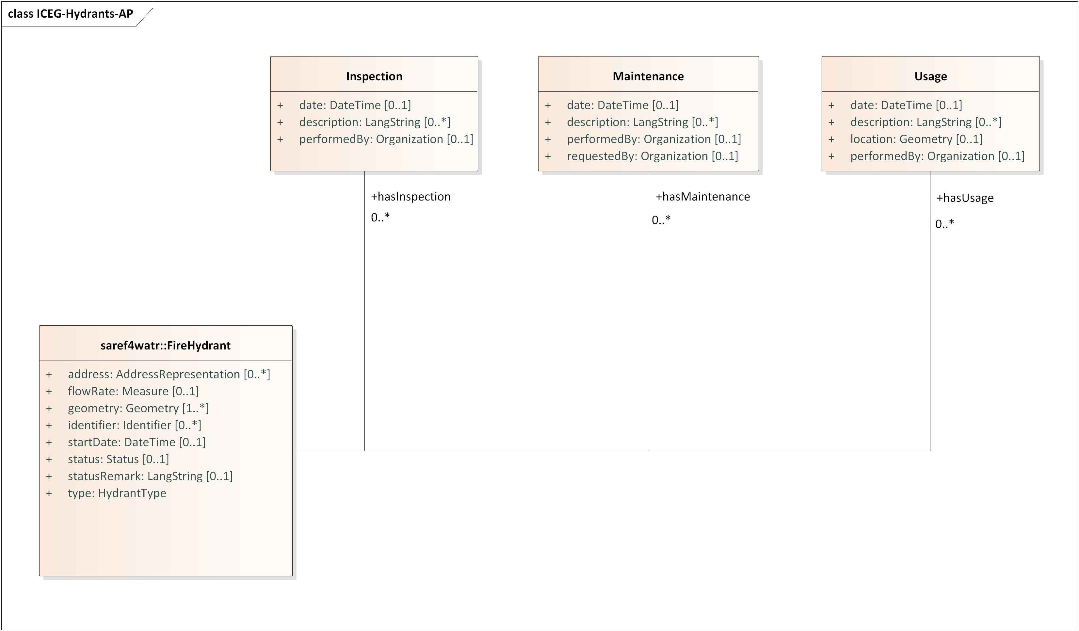
ICEG Hydrants
Updates to the model
Addition of classes based on information requirements of the water companies
Minor changes to cardinalities, definitions and usage notes
Full changelog via this link
Notes:
Optional fields -> rationale

Slide 14
ICEG Hydrants
What still needs to be done?
Further updates of the model based on the Working Group of 28/03/2024.
Facilitate additional discussions regarding the data model:
Cardinality
Additional attributes
Data types
…
Creation of additional data examples, following use cases requested by the stakeholders.
Preparation of an additional workshop & closing webinar.
Separate meeting with Aquawal and the other water companies in Namur to ensure consensus for the working group.
Stakeholder management of Flemish, Walloon and Brussels parties.
With the new MoU, additional budget has been granted in order to finalise the specification and achieve consensus between all parties. The editors would start with the activities listed above and propose to update the Committee regularly to monitor whether it is feasible to reach consensus.
Notes:
Optional fields -> rationale

Slide 15
ICEG BeStAdd Pauline De Wolf

Slide 16
Context
The guidelines for addresses are published in a static file which makes it difficult for developers and business analysts to process the underlying logic and guidelines.
A machine-readable model compliant with the static file would improve functionality and would harmonise this with other ICEG data specifications
Different implementations on all levels of Belgian government are already aligned with BeST Add but this is difficult to check and ensure conformity.
Notes:
Thematische WP:
Socio economische gegevens
Gezondheid
Water
Biodiversiteit
Werkgelegenheid en opleiding
Mobiliteit

Slide 17
Activity
Budget (13.000 euro) has been foreseen to assess the static file and create a UML diagram and other relevant serialisations (HTML, TTL, JSON-LD Context).
This would result in a non-validated version with an accompanying text highlighting next steps that could be decided on by a Working Group. The content has already been validated but certain model design decisions will need to be taken and thus validated.
Option A is to put all effort into the publication of the model in the ICEG style and consider this as an accredited version.
Option B is to put less effort in the publication but describe what design choices have been made which could serve as a starting point for a Working Group to validate these decisions.
Notes:
Thematische WP:
Socio economische gegevens
Gezondheid
Water
Biodiversiteit
Werkgelegenheid en opleiding
Mobiliteit

Slide 18
Update excercise translation datastandards Eveline Vlassenroot

Slide 19
Objective & scope
Objective: translate 135 recognized standards and 35 candidate standards into English, French and German
Publication: ICEG Github and Belgif website
Budget: 50% of total ICEG allocation
Notes:
Thematische WP:
Socio economische gegevens
Gezondheid
Water
Biodiversiteit
Werkgelegenheid en opleiding
Mobiliteit

Slide 20
Status & next steps
In 2025:
Update Toolchain v4 in order to facilitate translation
Identification of initial batch of standards
In 2026:
Start two tracks
Translation of standards
Publication of standards
Update Process & Method
Notes:
Thematische WP:
Socio economische gegevens
Gezondheid
Water
Biodiversiteit
Werkgelegenheid en opleiding
Mobiliteit

Slide 21
Overview 2 tracks
Track 1 – Translation
Translate OSLO Standards
Publish via instance of OSLO Toolchain v4 on ICEG GitHub
Collaboration with Bart H and team OSLO
Track 2 – Publication
Enhance Belgif portal for discoverability
Publish semantic models, vocabularies and their documentation
Improve UX and content workflow
Notes:
Thematische WP:
Socio economische gegevens
Gezondheid
Water
Biodiversiteit
Werkgelegenheid en opleiding
Mobiliteit

Slide 22
EU Survey Interoperability Framework/SDG Ziggy Vanlishout

Slide 23
Planning meetings 2026

Slide 24
Proposal meeting dates
Suggestion: 1-2 weeks before management meeting
Date | Meeting | Location
15/01/2026 | ICEG Review Comite | Belpaire
26/02/2026 | ICEG Review Comite | TBD
06/03/2026 | ICEG Management Comite | Online - 10:00-12:00
21/05/2026 | ICEG Review Comite | TBD
05/06/2026 | ICEG Management Comite | Online - 10:00-12:00
03/09/2026 | ICEG Review Comite | TBD
18/09/2026 | ICEG Management Comite | Online - 10:00-12:00
17/11/2026 | ICEG Review Comite | TBD
27/11/2026 | ICEG Management Comite | Online - 10:00-12:00
To confirm
To confirm
To confirm
To confirm

Slide 25
Other?

